Slide 1

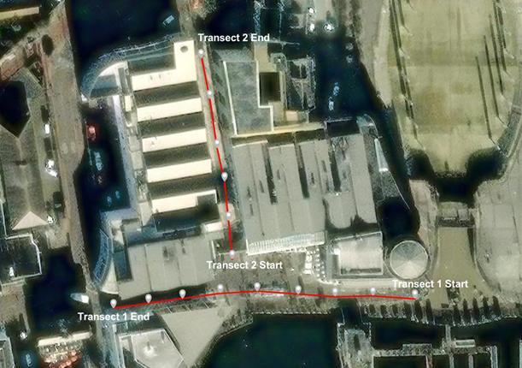
No counted features
1-2 features
3-4 features
Not in count

